Slide 1
BrainrotGame
By @prefetch_zuzu

Slide 2
WHAT IS BRAINROTGAME?
An idle/incremental game where players:
- Purchase characters from a shop
- Place them on basepads
- Earn passive income
- Upgrade earnings
- Grow their empire
Genre: Idle Tycoon / Clicker Game

Slide 3
CORE GAMEPLAY LOOP
Earn: Money passively from characters
Buy: New characters from shop lane
Place: Characters on tier-based basepads
Claim: Accumulated earnings
Upgrade: Multipliers for faster growth
Repeat: To unlock all tiers

Slide 4
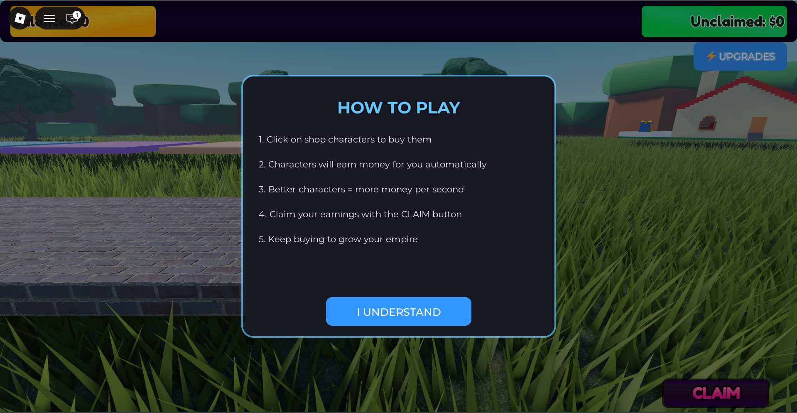
How to play?
Here are the instructions.

Slide 5
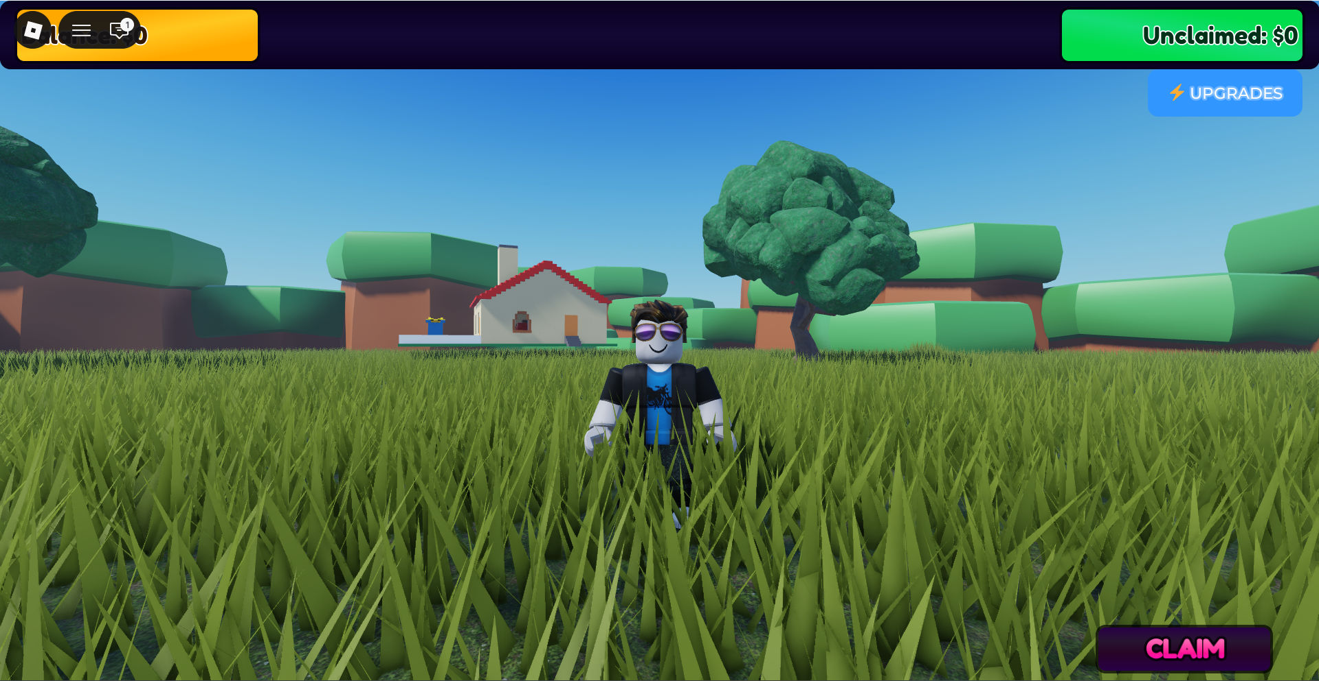
Hello everyone!
This is my avatar:
@prefetch_zuzu

Slide 6
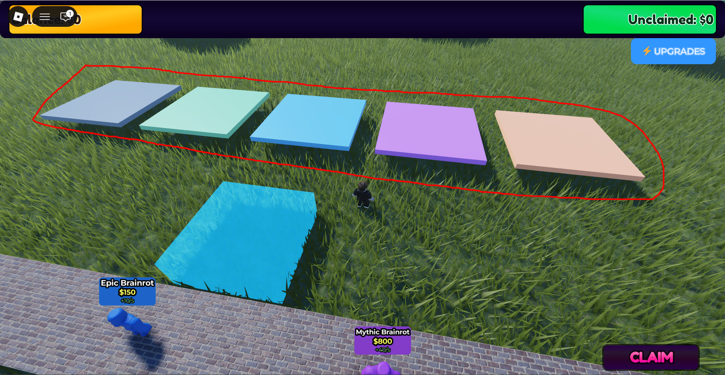
These are basepads where your purchased characters are stored.

Slide 7
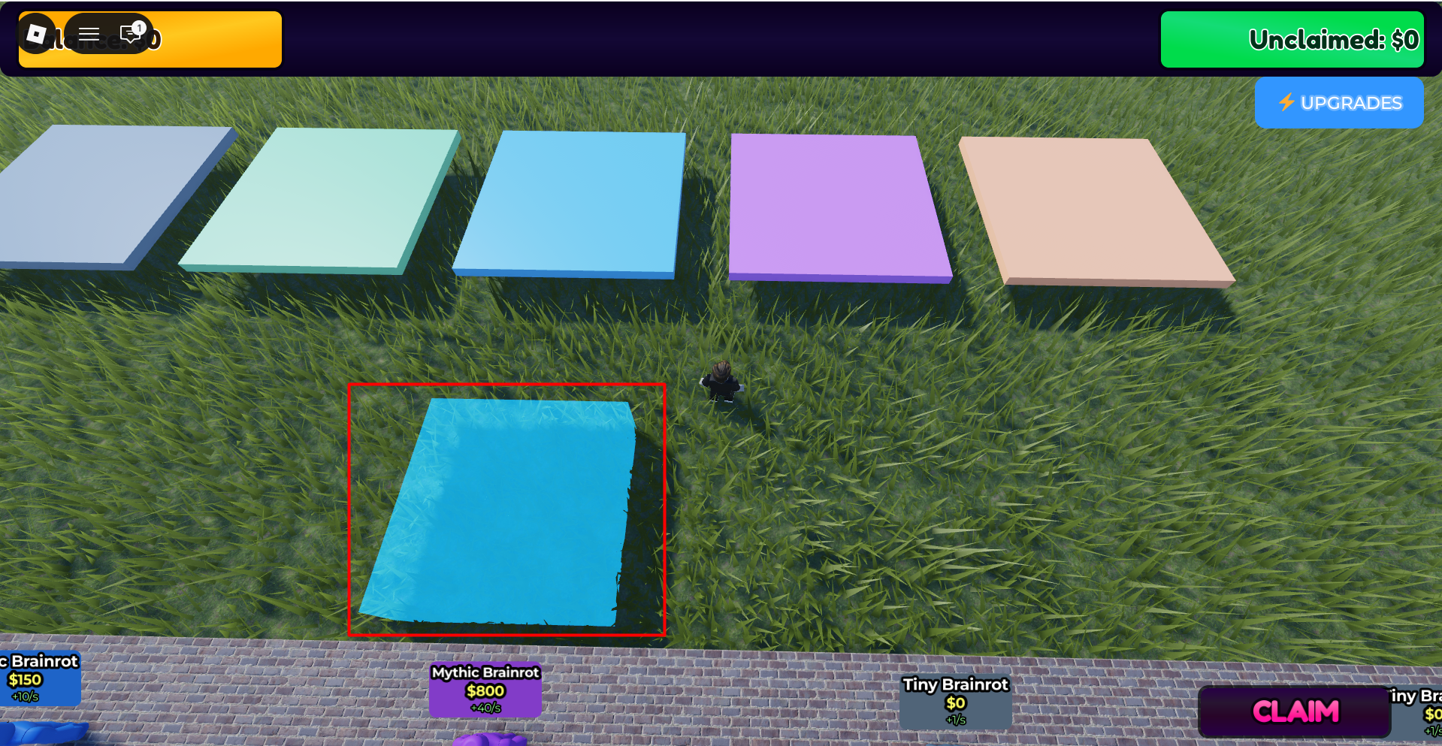
This is the Purchase Zone, where you have to stand to buy a character.

Slide 8
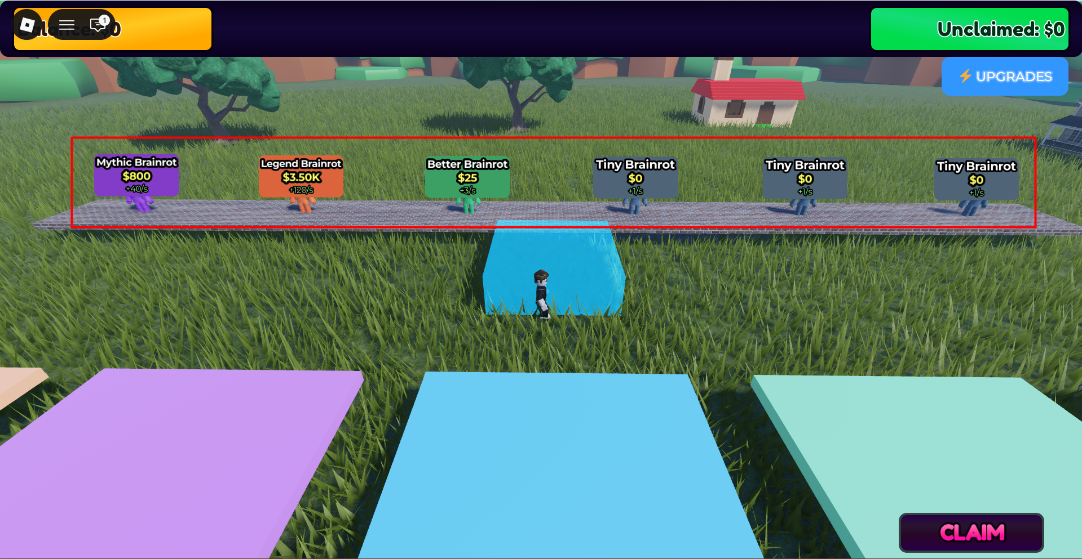
This is the Lane Path, where five different characters move from left to right.

Slide 9
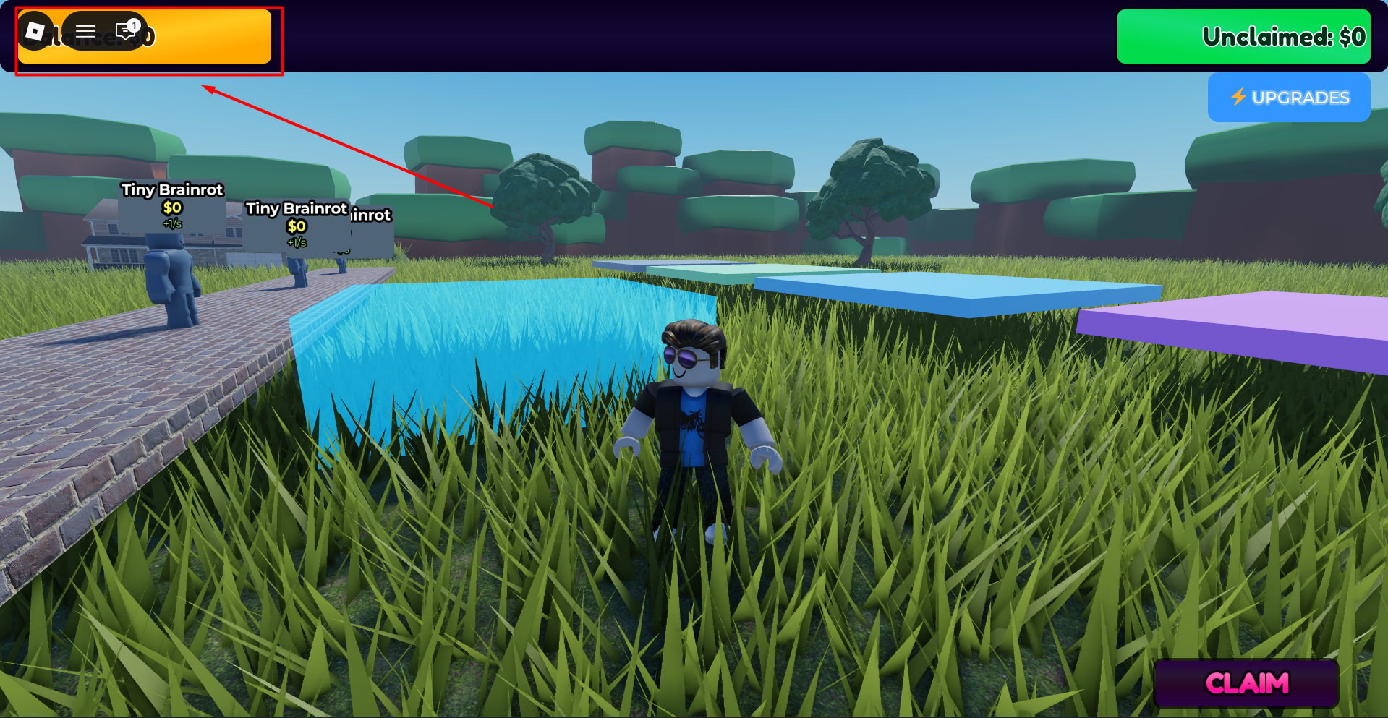
This is your balance.

Slide 10
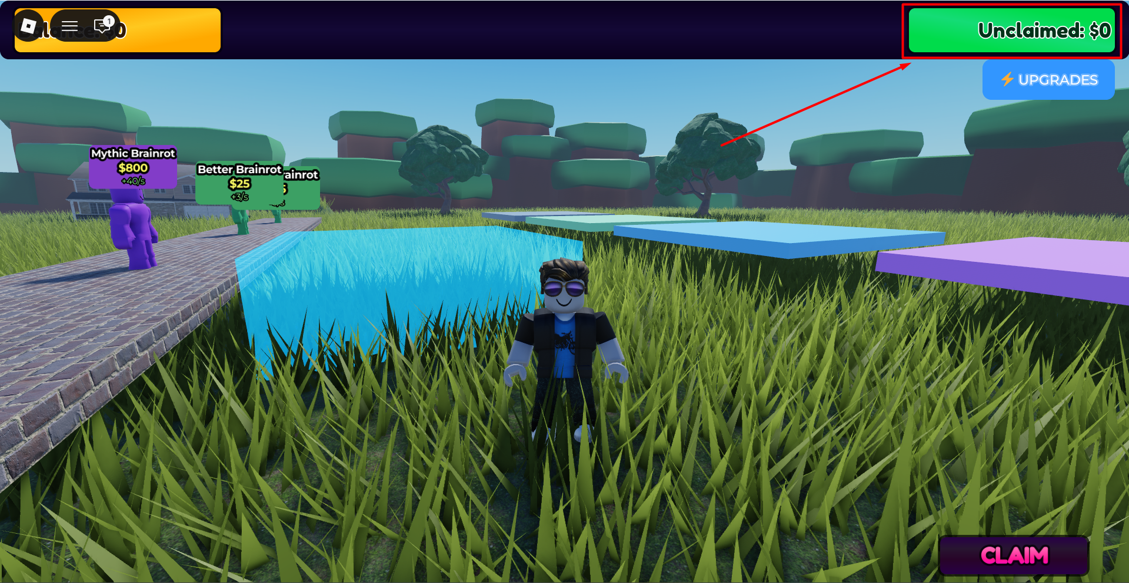
This is your unclaimed balance.

Slide 11
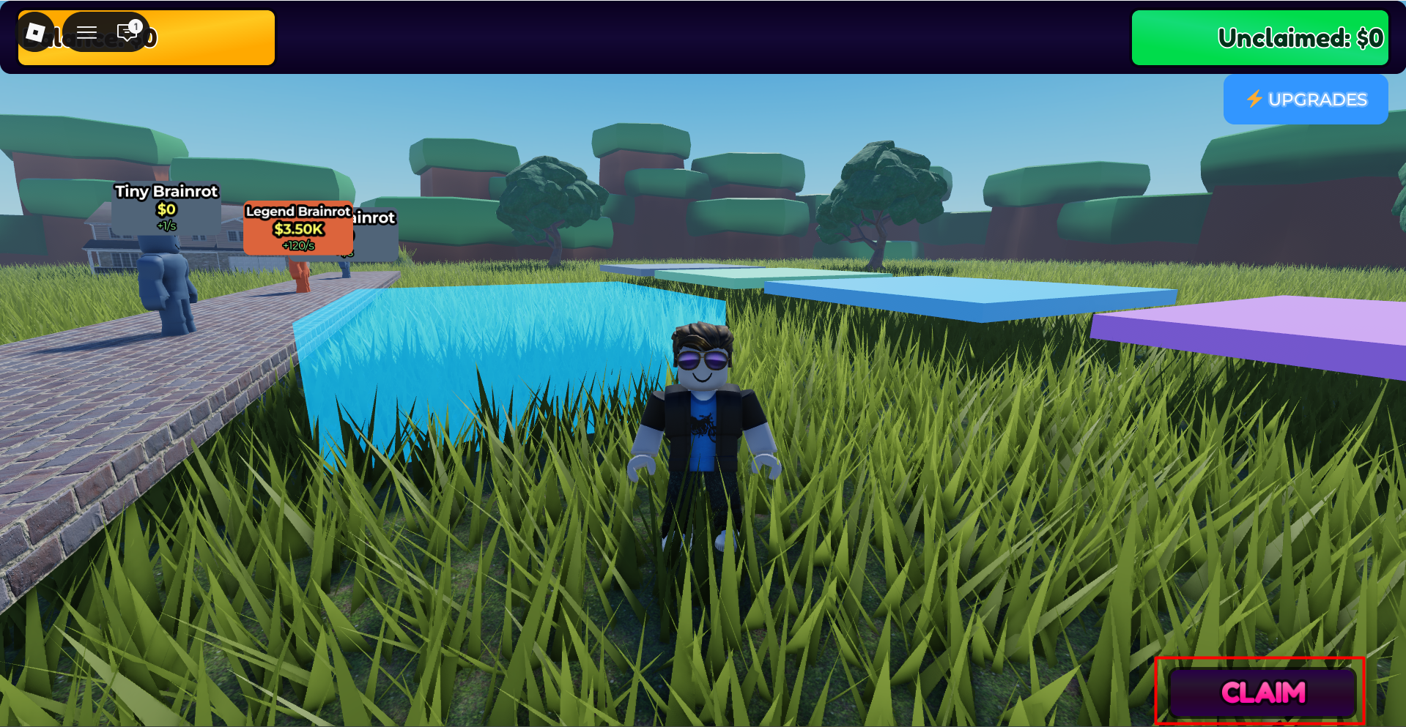
This is the Claim button. By clicking it, you can add the unclaimed balance to your main balance.

Slide 12
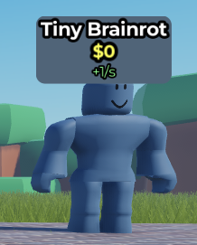
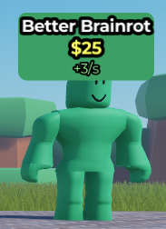
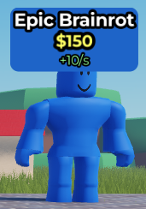
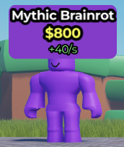
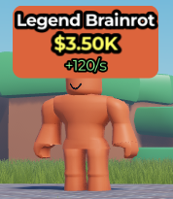
Tier | Name | Price($) | EPS | Picture
1 | Tiny Brainrot | 0 | 1
2 | Better Brainrot | 25 | 3
3 | Epic Brainrot | 150 | 10
4 | Mythic Brainrot | 800 | 40
5 | Legend Brainrot | 3500 | 120
Table: Character Data Model

Slide 13
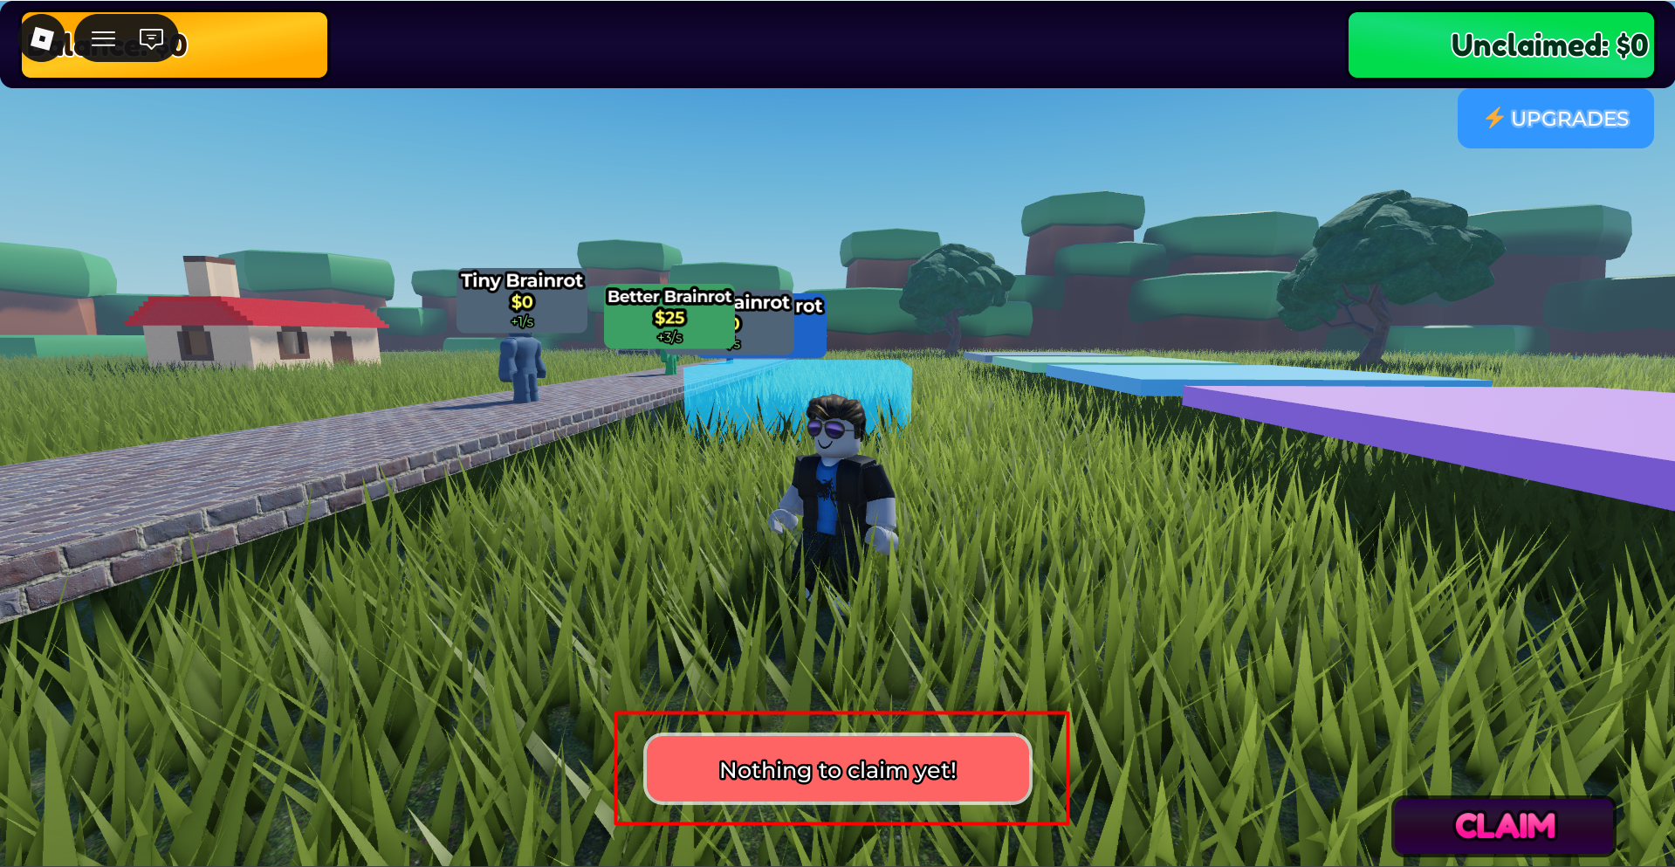
If your unclaimed balance is zero and you click the Claim button, you will receive an error message: “Nothing to claim yet!”

Slide 14
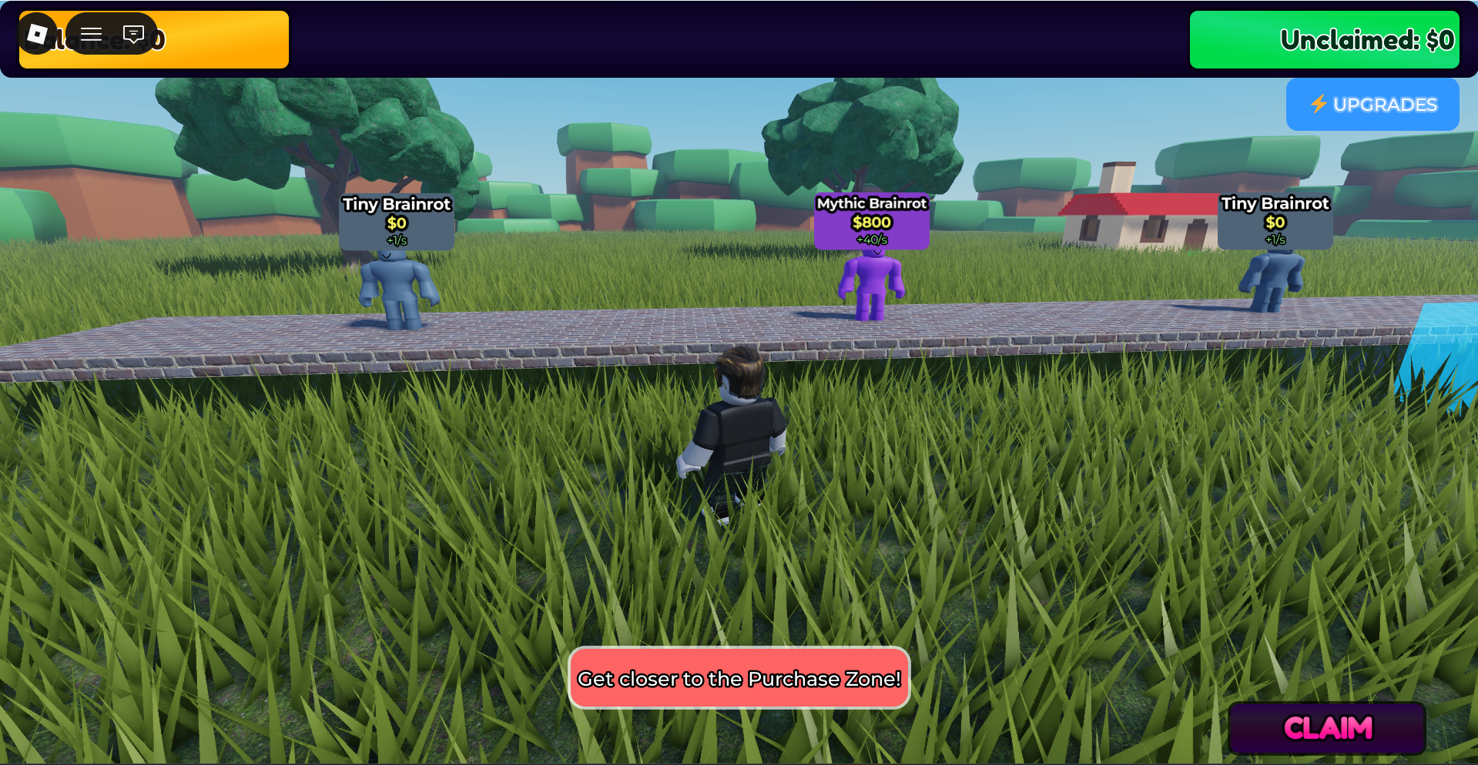
If you want to purchase a character, you just have to click on it. If you are not in the Purchase Zone, you will receive an error message: “Get closer to the Purchase Zone!”

Slide 15
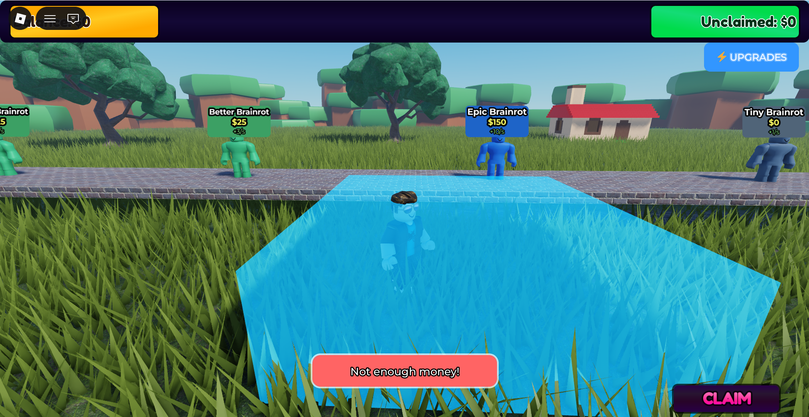
If you don’t have enough money, you cannot purchase a character.

Slide 16
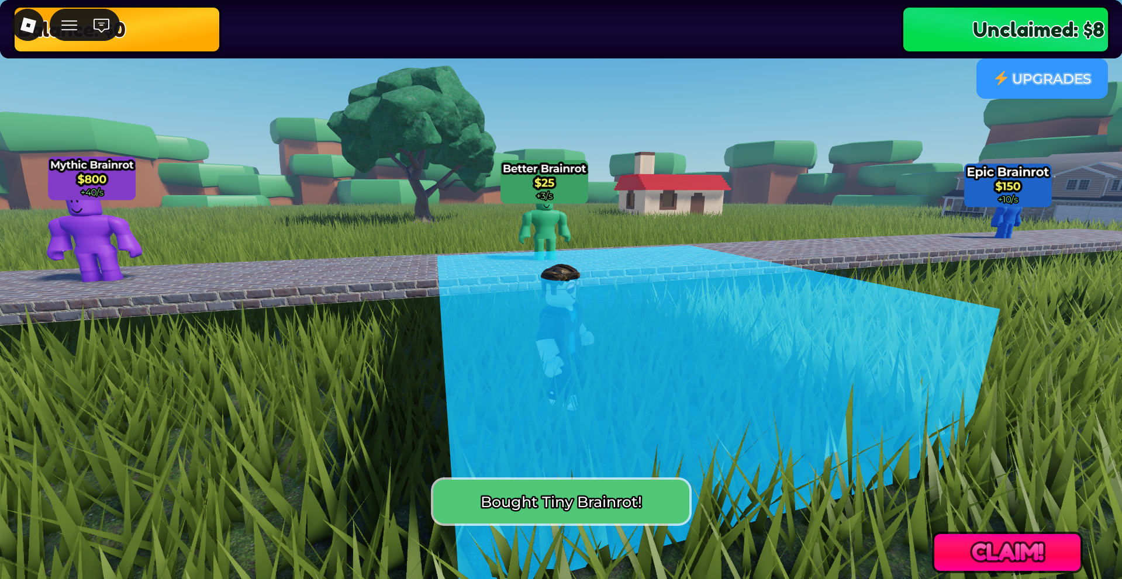
When you purchase a character or click on a character, a success message will appear: “Bought character_name.”

Slide 17
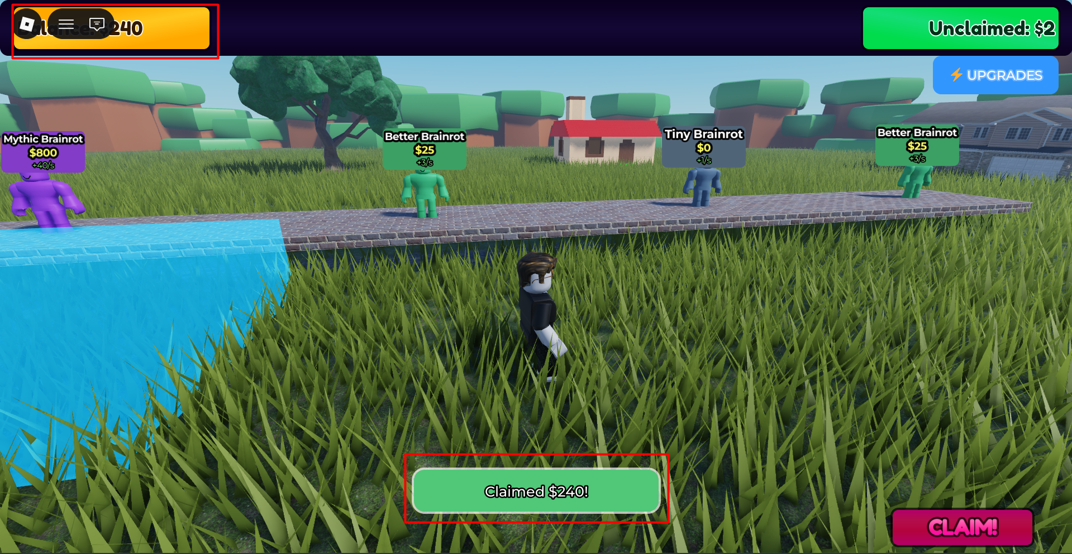
2. Your balance will be updated accordingly.
1. When you have money to claim, you can click the Claim button.

Slide 18
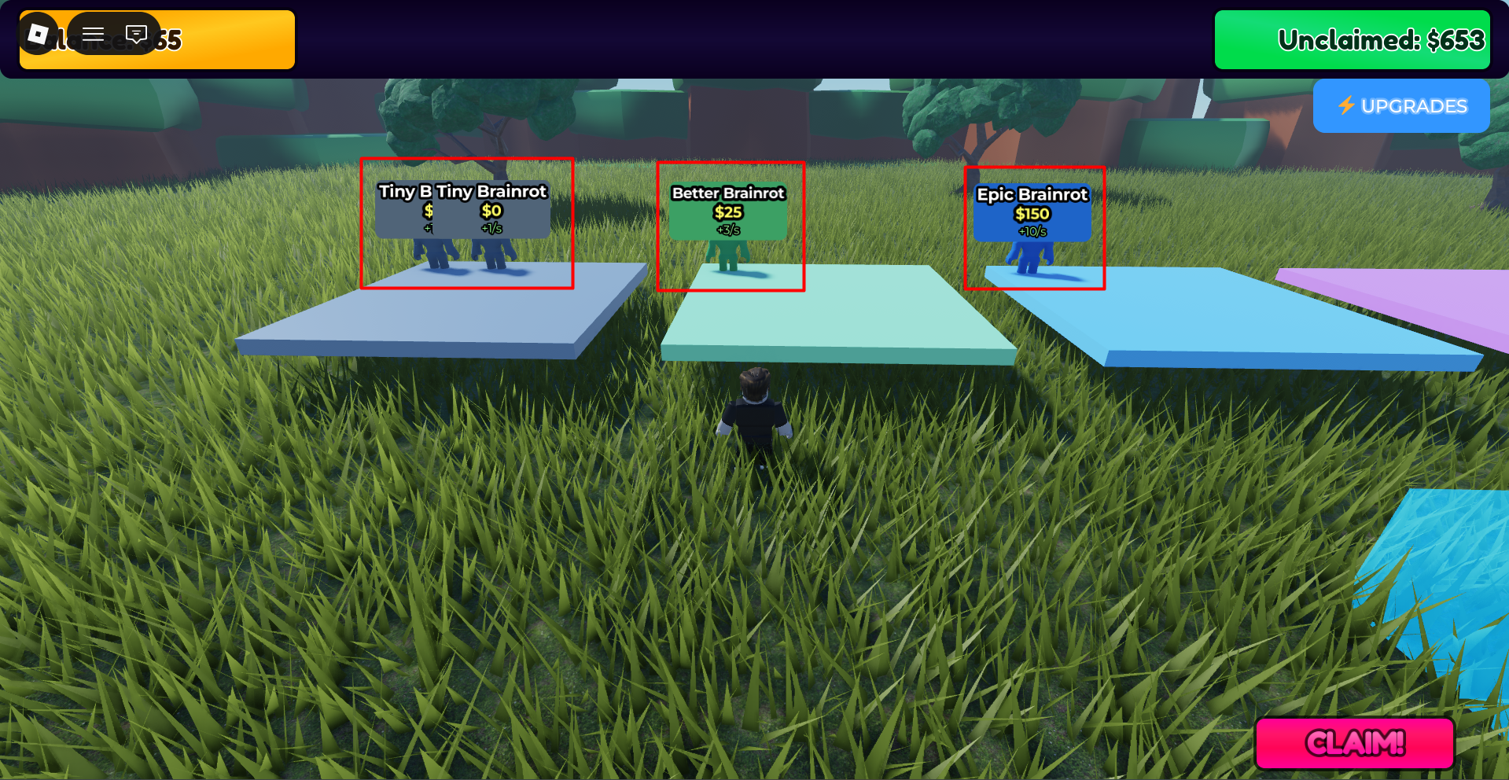
Your purchased characters will be stored in their respective basepads.

Slide 19
UPGRADE SYSTEM
Two Upgrade Paths:
Claim Multiplier
5 levels: 1.0x → 2.5x
Increases offline earnings
Delivery Speed
6 levels: 1x → 7x
Faster earnings generation

Slide 20
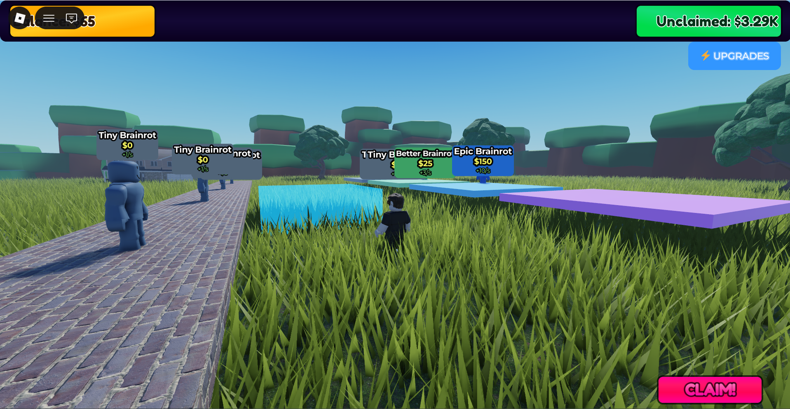
You can upgrade your base

Slide 21
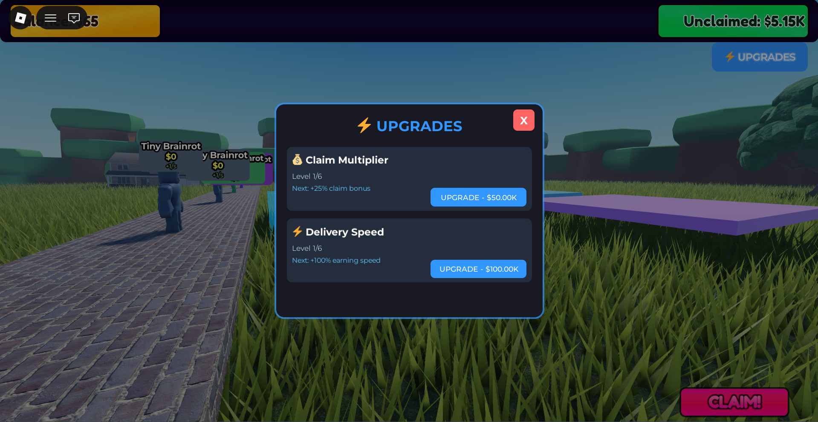
1. You can upgrade the Claim Multiplier.
2. You can upgrade the Delivery Speed.

Slide 22
DATA PERSISTENCE
What Gets Saved:
- Player balance
- Unclaimed earnings
- Purchased characters
- Upgrade levels
- Tutorial completion
Offline Earnings:
- 50% of regular EPS
- 12-hour accumulation cap
- Calculated on rejoin

Slide 23
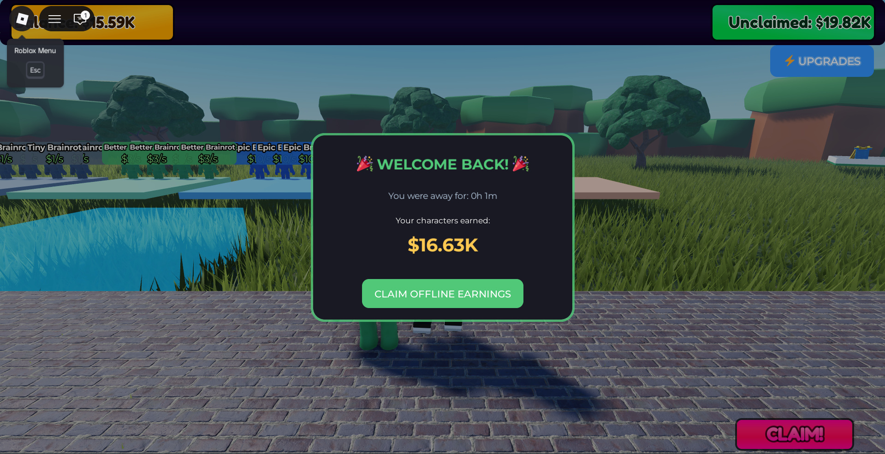
Offline Feature:
If you go offline, no problem your characters will continue to earn, but you will receive only 50% of the earnings.

Slide 24
TECHNICAL ARCHITECTURE
8 Server Services:
├── CurrencyService → Money management
├── PurchaseService → Purchase validation
├── BaseService → Earnings calculation
├── BasePadService → Character placement
├── ShopLaneService → Shop spawning
├── SavingService → DataStore persistence
├── UpgradeService → Upgrade system
└── TutorialService → First-time tutorial

Slide 25
PROJECT STRUCTURE
BrainrotGame/
├── src/
│ ├── server/ (8 services)
│ ├── client/ (2 scripts)
│ └── shared/Config/ (3 config files)
├── docs/
│ ├── BACKEND_API.md
│ ├── UI_DESIGN.md
│ └── README.md
└── default.project.json

Slide 26
LIVE DEMO
Play Now:
https://www.roblox.com/games/126705578084525/BrainrotGame
GitHub Repository:
https://github.com/waliulrayhan/BrainrotGame

Slide 27

Thanks!
Presented By, Md. Waliul Islam Rayhan Email: b190305034@cse.jnu.ac.bd

